Slide 1
Impact of Quality of Image Database on AI Performance in Skin Cancer Detection
Yixuan Li
Supervisor: Prof. Patrice Delmas
22 November 2022

Slide 2
Motivation
> 82,000 New Zealanders get skin cancer every year
Due to depletion of ozone layer, this number is increasing 10-20% annually, accounting 80% of all new cancers in NZ.
Melanoma is the most deadly one in all skin cancers, accounting <5% of all skin cancers, but responsible for >75% of total death.
the highest incidence rate from melanoma NZ > Australia > European countries.
Most skin cancers can be prevented if detected early.
Major cause : Over-exposure of UV rays

Slide 3
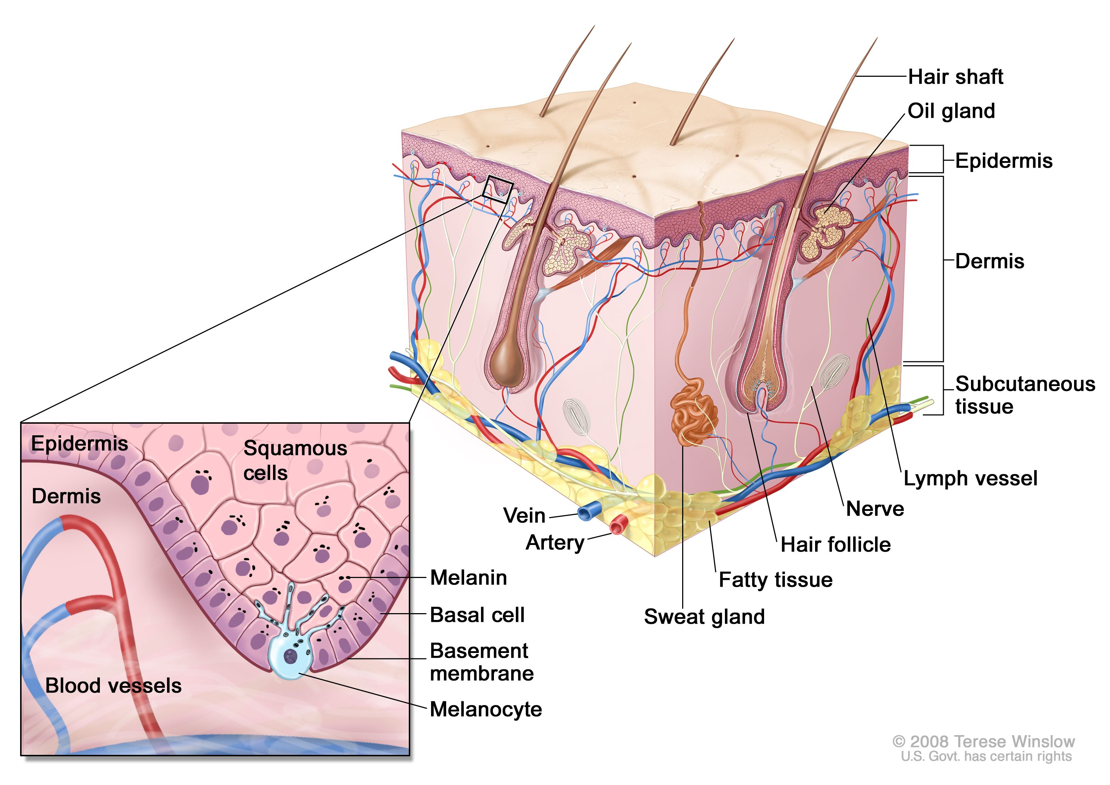
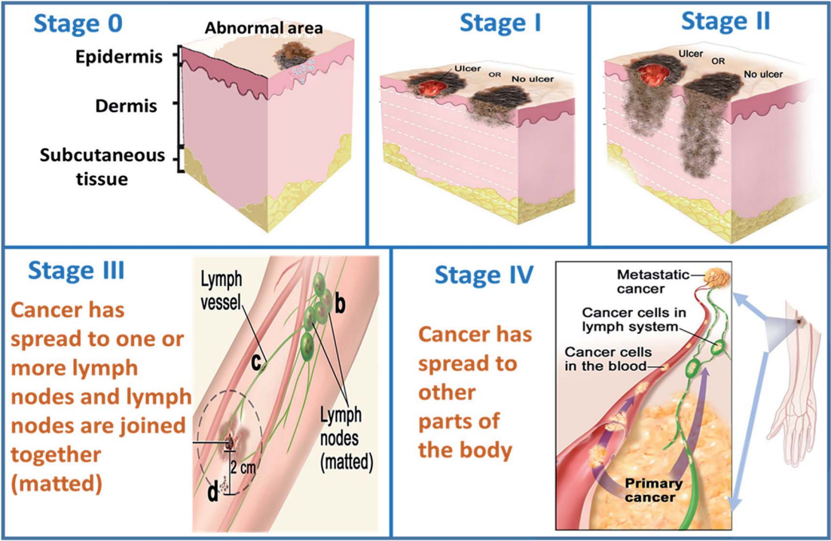
Introduction
Early detection would increase Melanoma 5 years’ survival rate from 15% to 99%.
Normal Skin
Five Stages of Skin Cancer

Slide 4
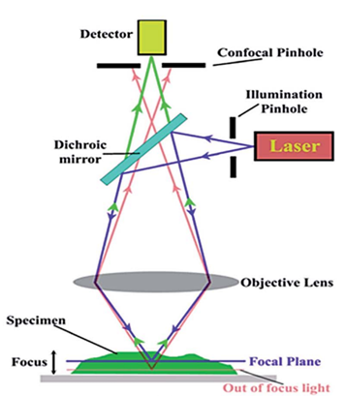
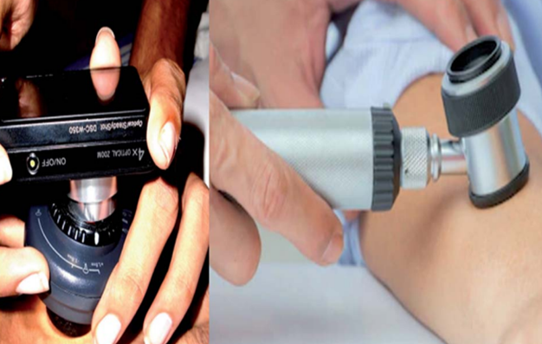
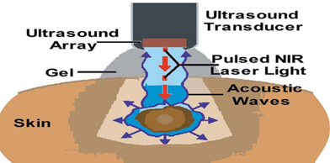
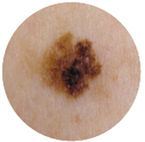
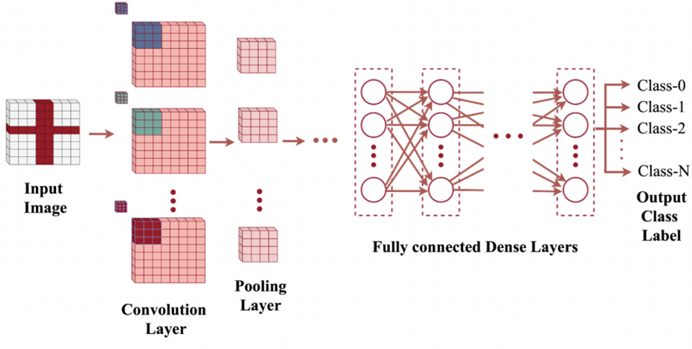
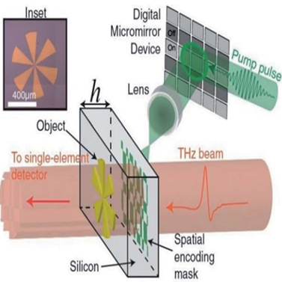
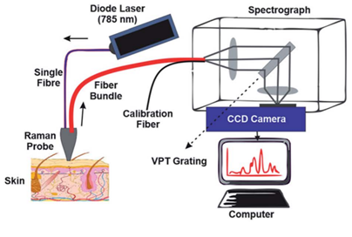
Non-Invasive Detection of Skin Cancer
Dermatoscopy
High-frequency ultrasound
Fast, Easy Accessible,
Low-cost,
Reflectance Confocal Microscopy
Raman spectroscopy
2D – Convolutional Neural Network
Tetrahertz Spectroscopy

Slide 5
Research Questions
How to track, analyze, manage image database modification
How to track uniqueness of image files and archive them in SQL database
What is the relationship of the quality of AI Database to the model performance

Slide 6

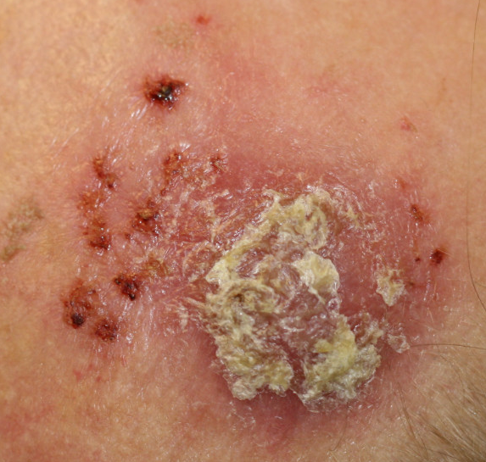
Methods
Structure of AI database: three-level labeling system
Image-hashing to track uniqueness of images
L0
L1
L2
….
….
….
SHA256
Hash Code (256 bits)
44f3142b5c659e96ca4557b5d45f061e3479ca49aa3e0ed4a27fcb412502d88f

Slide 7
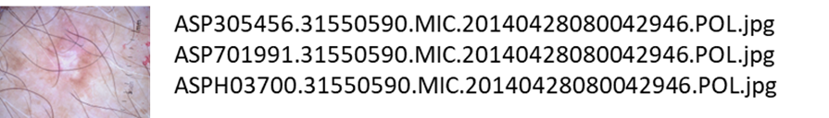
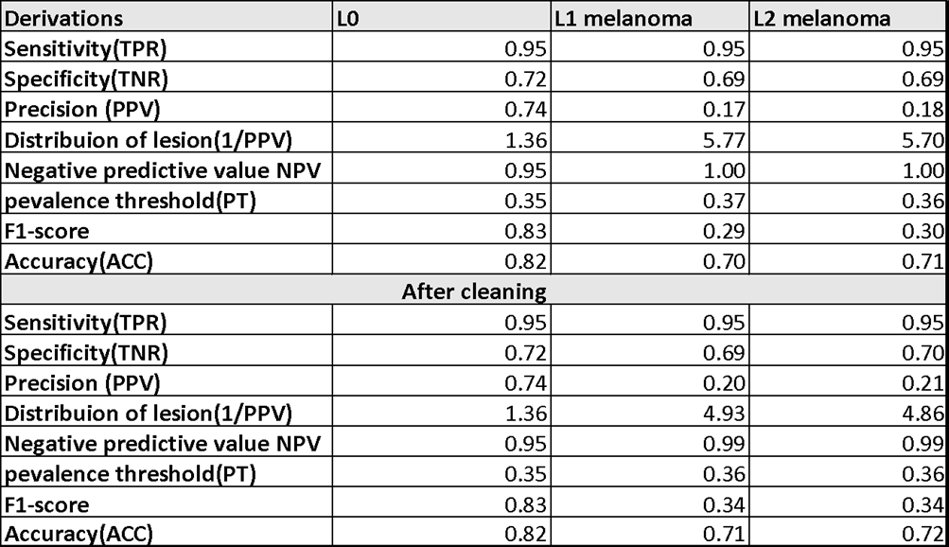
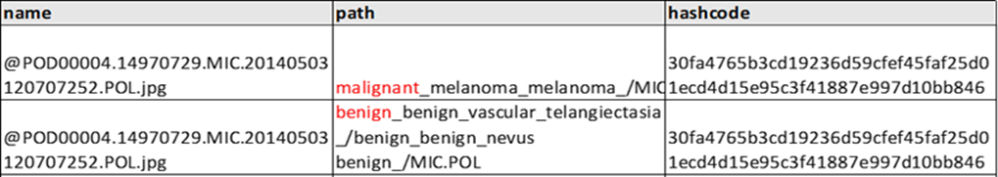
Statistical Analysis on AI database
Three kinds of errors in AI database:
1, 0.15% Redundancy due to multi-upload error
2, 0.22% Cross-labelling
3, 22.56% Repetitive - labelling
Deleted + some re-labellings

Slide 8
Simulation with Melanoma Dataset
Use EfficientNet CNN model on ISIC Melanoma Detection Dataset with 5%, 10% and 20% redundancy of both
Cross-labelling
Repetitive-labelling
Cross-labelling would potentially damage AI performance, while unclear in repetitive-labelling.

Slide 9
Future Prospects
Boost accuracy via pre-processing (e.g., ESRGAN) and post-processing (e.g., Xgboost)
Manage class imbalance and skin-color bias of AI database and their connection to AI performance
Incorporate CNN model with metadata ML models

Slide 10
Selected References:
“New Zealand skin cancer statistics,” Science Learning Hub, https://www.sciencelearn.org.nz/resources/1329-new-zealand-skin-cancer-statistics (accessed Nov. 18, 2022)
Narayanamurthy, Vigneswaran et.al., "Skin cancer detection using non-invasive techniques, "RSC Adv., Vol.8, issue 49, pp. 28095-28130, 2018. doi : 10.1039/C8RA04164D.
“PDQ Adult Treatment Editorial Board, Melanoma Treatment (PDQ®): Health Professional Version, “ PDQ Cancer Information Summaries. https://www.ncbi.nlm.nih.gov/books/NBK66034.1/ (accessed Nov. 18, 2022)
S. Niyas, S.J. Pawan, M. Anand Kumar, Jeny Rajan, “Medical image segmentation with 3D convolutional neural networks: A survey,” Neurocomputing, Vol. 493, pp. 397-413, 2022. [online] Available: https://doi.org/10.1016/j.neucom.2022.04.065.
Esteva, A., et al., “Dermatologist-level classification of skin cancer with deep neural networks,” Nature, vol. 542, pp. 115–118, 2017, https://doi.org/10.1038/nature21056
Thank you!
Questions?

Slide 11
Backup
SHA256: The probability of just two hashes accidentally colliding is approximately: 4.3*10-60

